Slide 1

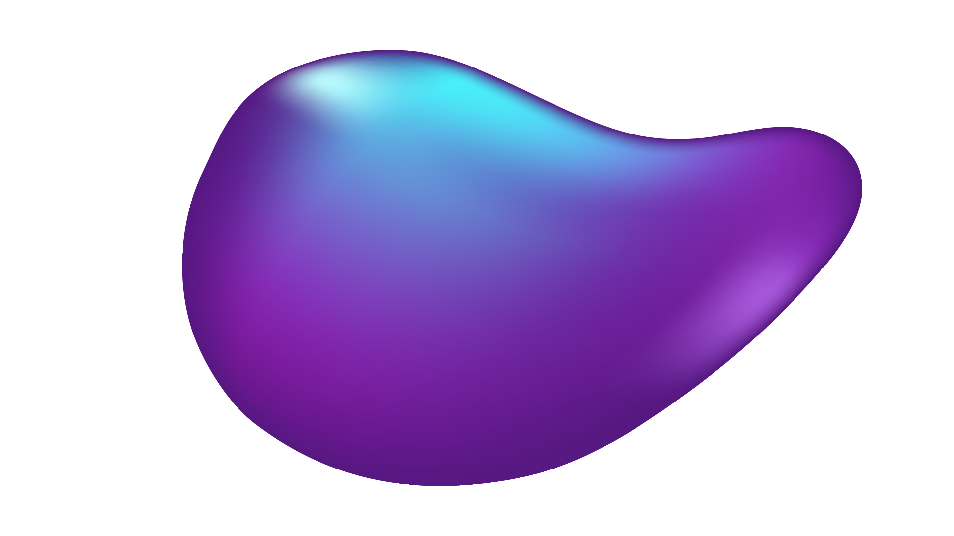
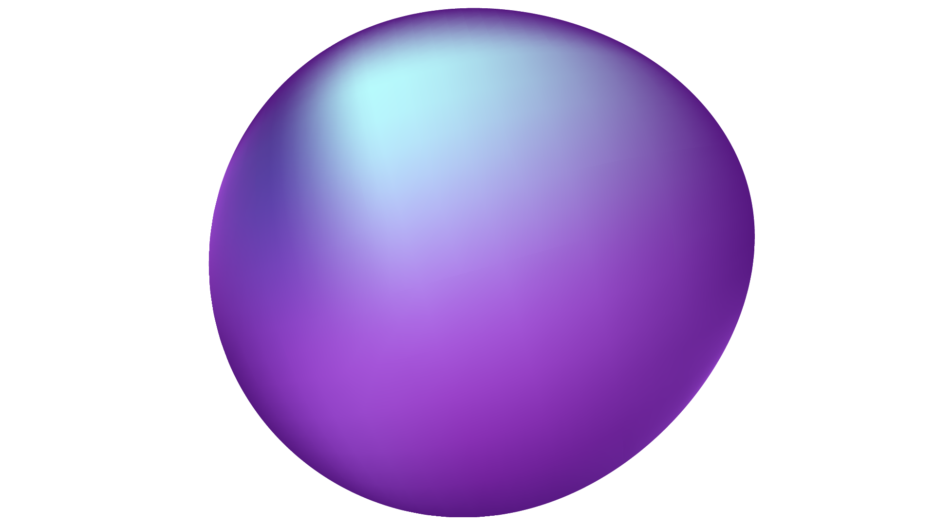
AI Agent
For Documentation and Summation
Abhisar Anand, Brayan Cano, Shar Min, Ali Mutlek, Dhyan Patel, and Myles Edwards

Slide 2
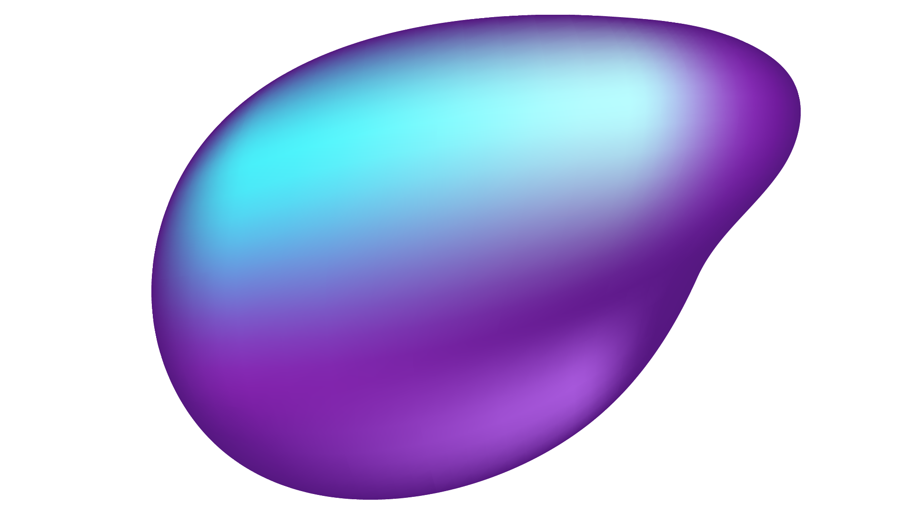
OUR TEAM
Abhisar Anand
Ali Mutlek
Brayan Cano
Team Lead
Android App Development
AI/ML Development
Dhyan Patel
Myles Edwards
Shar Min
Backend Development
Frontend Development
AI/ML Development

Slide 3
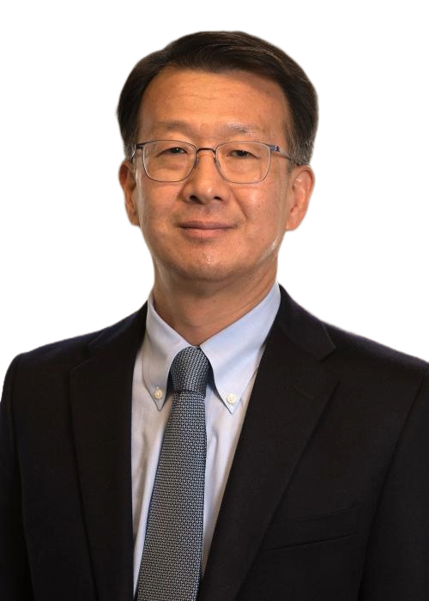

OUR TEAM
Dr. Beonjin Kim
Faculty Advisor
PFW IA and VC
Sponsor

Slide 4

PROBLEM
Note taking is prone to inaccuracies, can be inefficient and burdensome.​
Clinical documentation (medical jargon) can often lack patient clarity.​
"A recent study found that for every eight hours physicians spend with patients, they spend another five on the EHR." - Lauren Funaro
27% on direct clinical face time with patients.​

Slide 5
SOLUTION
A seamless end to end platform that can:​
Record conversations​
Transcribe speech to text​
Speaker Attribution (doctor, patient, etc)
AI summarization of key details​
Perform trend analysis

Slide 6
ESSENTIAL REQUIREMENTS
Record audio and upload
Convert speech to text with speaker attribution
PII Redaction (HIPPA Compliant)
Note Summarization using SOAP
Beautiful Dashboard
Convert audio to structured data

Slide 7
NONESSENTIAL REQUIREMENTS
Multilingual Support
Realtime/Live Transcription
OCR for Scanned Notes
Self-Contained (processes locally)

Slide 8
EXPECTED DELIVERABLES
2025:
Wireframe
UML Diagram
DB Schema Design
SOAP Formatting
Basic Prototyping
2026:
Dashboard Integration
Proper redaction
Patiently-friendly summary
Speaker Identification
Stretch Goals

Slide 9
RISKS AND CHALLENGES
HIPPA Compliance
Speaker Identification
Limited Access to Medical Data
Hardware Constraints

Slide 10
TECHNOLOGY & RESOURCES
Speech To Text (TBD)
OpenAI Whisper​
Vosk API​
Recording Device​
Android Phone​
Server Hardware (TBD)​
GTX 1080 Ti (University Provided)​
IDE​
Android Studio​
Visual Studio​
Version Control
Github
Communication
Discord
Outlook
Sprint Planning
Zoho​

Slide 11
PROJECT GOALS
Speech to Text
Accurate Transcription, Speech Attribution
Database
Secure DB to store medical data
AI Agent
Analyze Audio Files, Perform Trend Analysis, and etc.

Slide 12
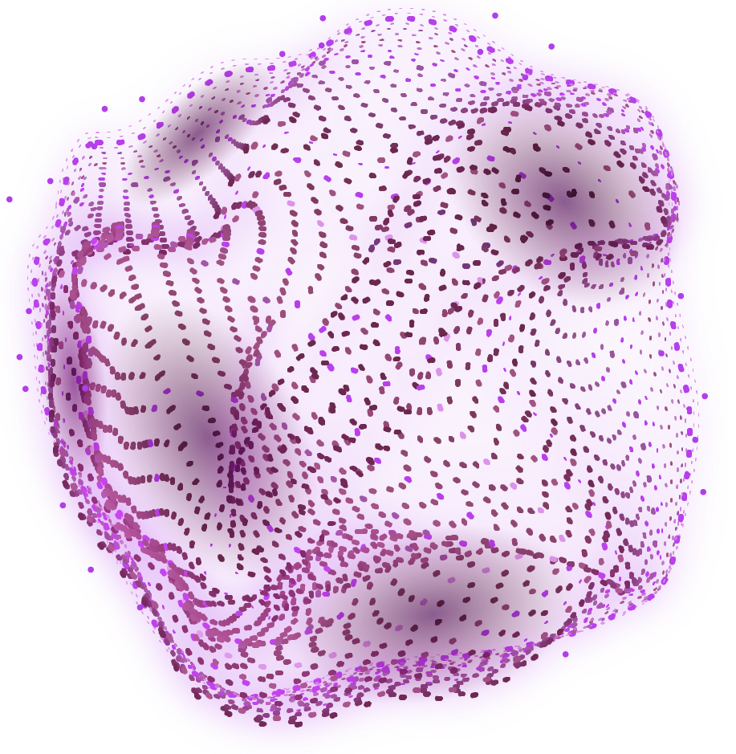
Thank you! ANY QUESTIONS

